Slide 1
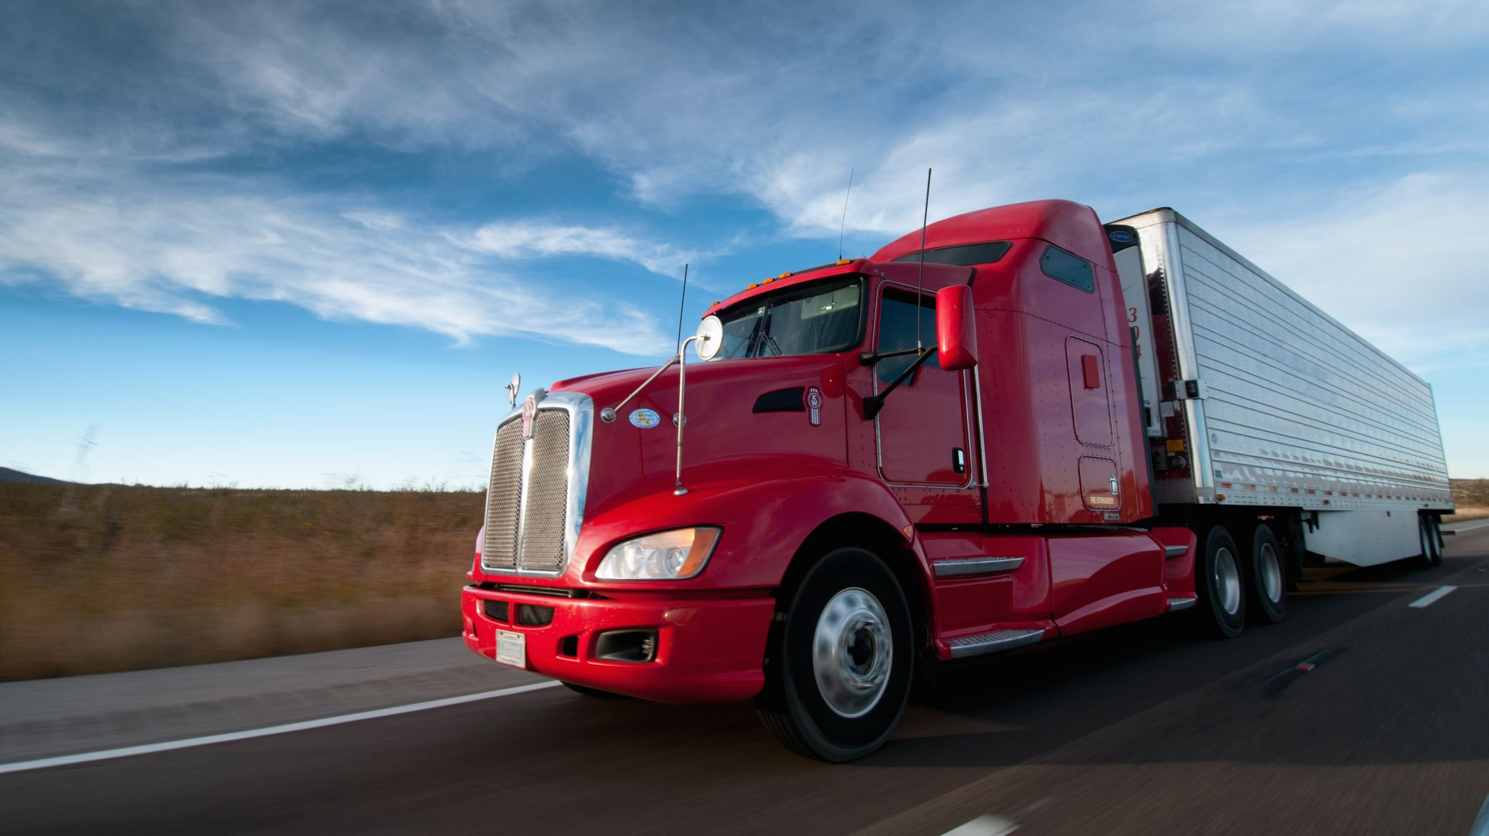
Az National Trucking Risk Analysis

Slide 2
Problem Statement
As the fleet manager of AZ National Trucking, our foremost challenge is to ensure adherence to company regulations, aiming to reduce insurance risks. This encompasses tackling issues such as speeding, unsafe following distances, lane departure incidents, and other hazardous driving practices among our fleet drivers.
Objectives
Assist fleet managers in identifying dangerous drivers with a risk threshold greater than 7
Identify hazardous Truck model nationwide
Identify violations based on geographic location
Determine the contribution of trucks, drivers, and geographic location to risk

Slide 3
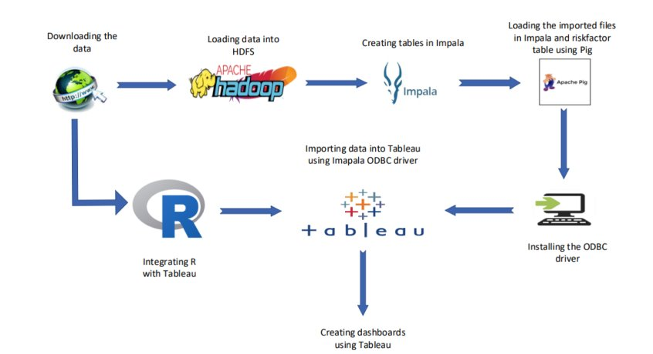
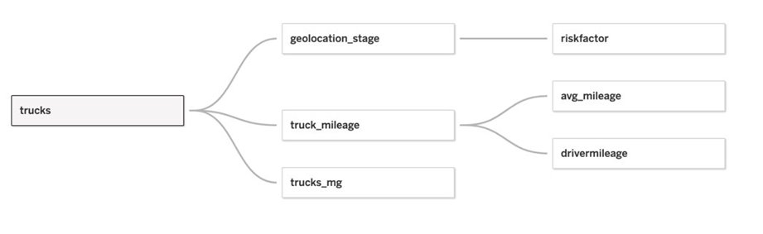
Data Exploration & Workflow

Slide 4


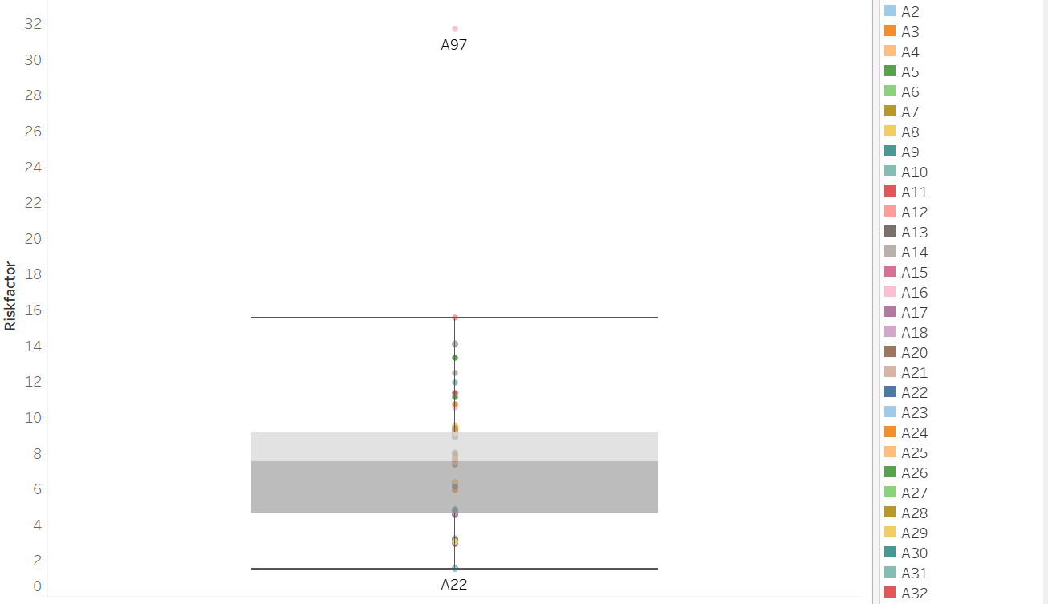
Outlier presence in Dataset??
Yes. Driver A97
How do we address
this outlier?
Remove driver A97

Slide 5
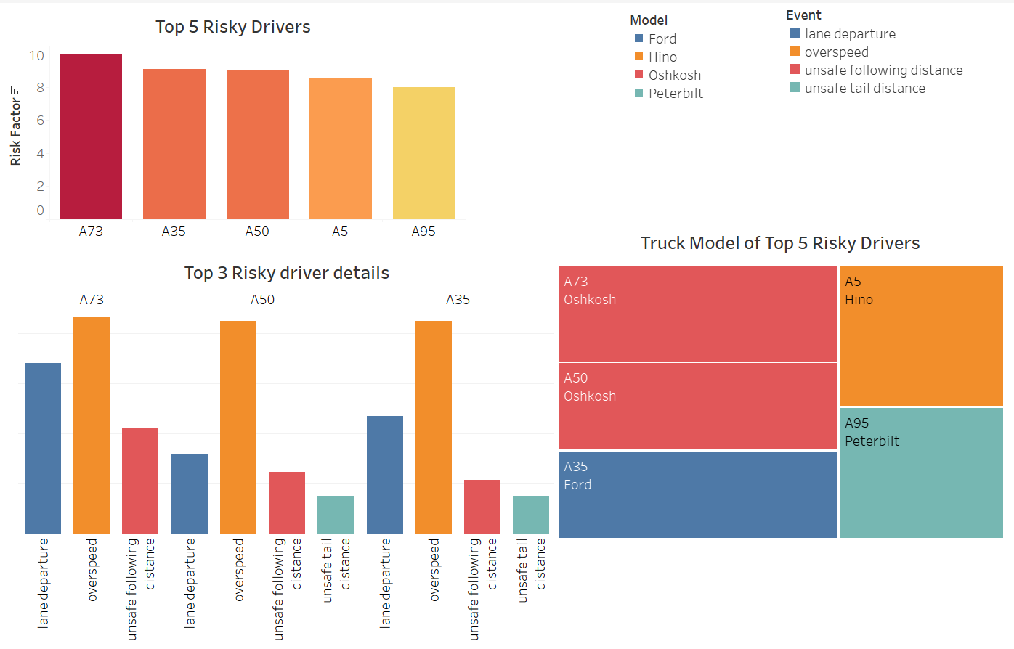
What are the factors causing them risky drivers?
Among all, driver A97, A73 & A35 are the top 3 riskiest drivers.
Over speeding is the most common event among all the three drivers.
Oshkosh Model is on top followed by ford when analyzing the risk.

Slide 6
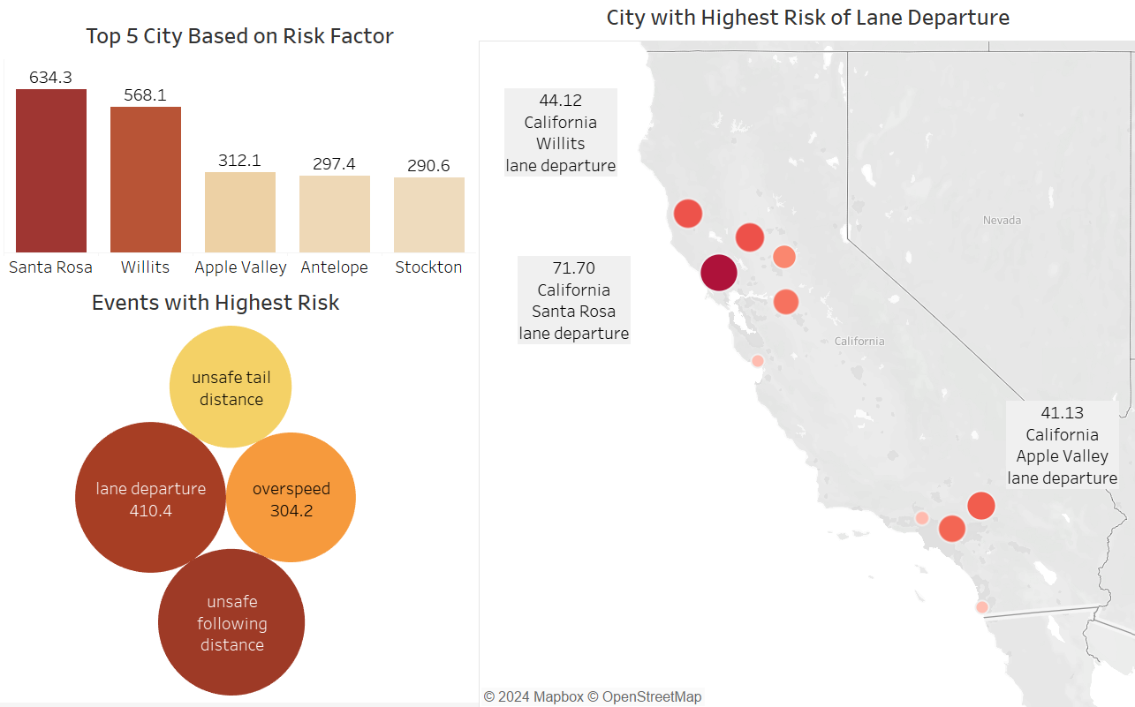
Santa Rosa city in California shows the highest risk, closely followed by Willits and Apple Valley.
Is over speeding the only cause?
Are the geographical factors contributing to the increase in risk?
Lane departure is the most prominent issue with risk factor of 410.0
All the top 3 riskiest cities have accidents happening because of lane departure.

Slide 7
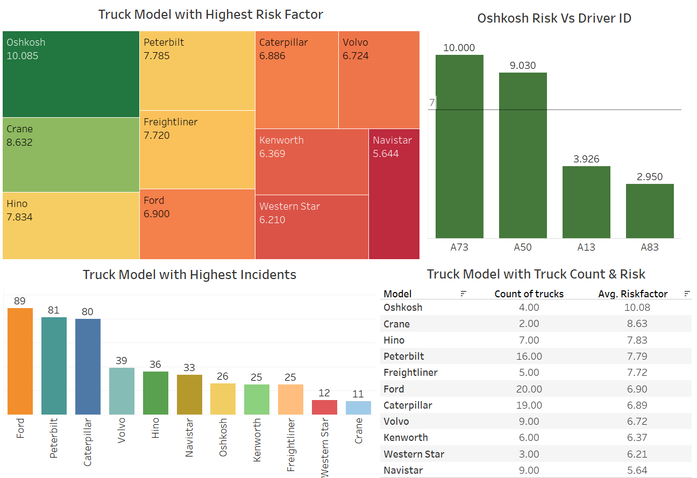
Are the truck models also a contributing factor in risk, in addition to drivers and geography?
Oshkosh continues at the top
When we set the threshold risk factor as 7.00, Driver ID A73 & A50 takes first two places.
But why is the risk factor highest for Oshkosh when Ford has more no of incidents?
Despite ford having 20 trucks, Oshkosh with only 4 trucks experiences events resulting in the highest risk factor.

Slide 8
CONCLUSION
Truck ID A97 is an outlier, prompting a detailed investigation by authorities to determine the underlying cause.​
Truck ID A73 is identified as the most likely source of accidents, highlighting the importance of sharing this information with other states and cities in California.​
The risk factor for each driver is influenced by the truck model, with Oshkosh trucks posing the highest risk.​ Even though Ford is responsible for most incidents Oshkosh brand trucks are the most hazardous among all. Thus, delving deeper into the data is important.
Santa Rosa is riskiest city with Lane departure is identified as the primary risk-causing event, suggesting that proper investigation of quality of roads & implementing features like lane assist can significantly mitigate risk.

Slide 9
Thank you

